Slide 1
Future Cosmic Surveys
DOE OHEP Cosmic Visions: Dark Energy
NAC’s “A Strategy to Optimize the U.S. Optical and Infrared System in the Era of LSST” (Elmegreen report)
Report on Kavli Futures Symposium (NOAO,LSST): “Maximizing Science in the Era of LSST: A community Based Study of Needed U.S. OIR Capabilities”

Slide 2
Cosmic Visions: Dark Energy
The Cosmic Visions Dark Energy group was formed by the DOE’s Office of High Energy Physics in August 2015 as a 2-way communication group with the HEP community: Scott Dodelson (Chair), Katrin Heitmann, Chris Hirata, Klaus Honscheid, Aaron Roodman, Uros Seljak, Anze Slosar, Mark Trodden.
Two other CV groups (CMB and Dark Matter) coordinate with DOE.
CMB is in a different phase: The CMB-S4 community-based collaboration released a first version of their Science Book (1610.02743). The HEP CV-CMB group has people in the collaboration and is concentrating on coordinating the HEP community activities.
We are now starting along the same process (building broad community and developing strong science case) and are about 1-2 years away from a Science Book (good timing for Decadal Survey)

Slide 3
Process
Between formation and the end of January 2016, the group of eight members held weekly telecons. Representatives of the group met with leaders of DESI at their November collaboration meeting and with leaders of the LSST Dark Energy Science Collaboration at their October collaboration meeting. There were three workshops held to gather input for the three white papers:
Brookhaven, October 1, 2015. Agenda and slides available at https://indico.bnl.gov/categoryDisplay.py?categId=124
Fermilab, November 10, 2015. Agenda and slides available at https://indico.fnal.gov/conferenceOtherViews.py?view=standard\&confId=10639
SLAC, November 13, 2015. Agenda and slides avaiable at https://indico.fnal.gov/conferenceDisplay.py?confId=10842
The group of eight met for a one day face to face meeting on January 14, 2016 at Fermilab.
Two papers were submitted to the arXiv:
1604.07626
1604.07821

Slide 4
Findings
Broad range of improvements from guaranteed to searches
Not just Dark Energy
[1] Even after DESI and LSST, there will be a lot of information left in the sky

Slide 5
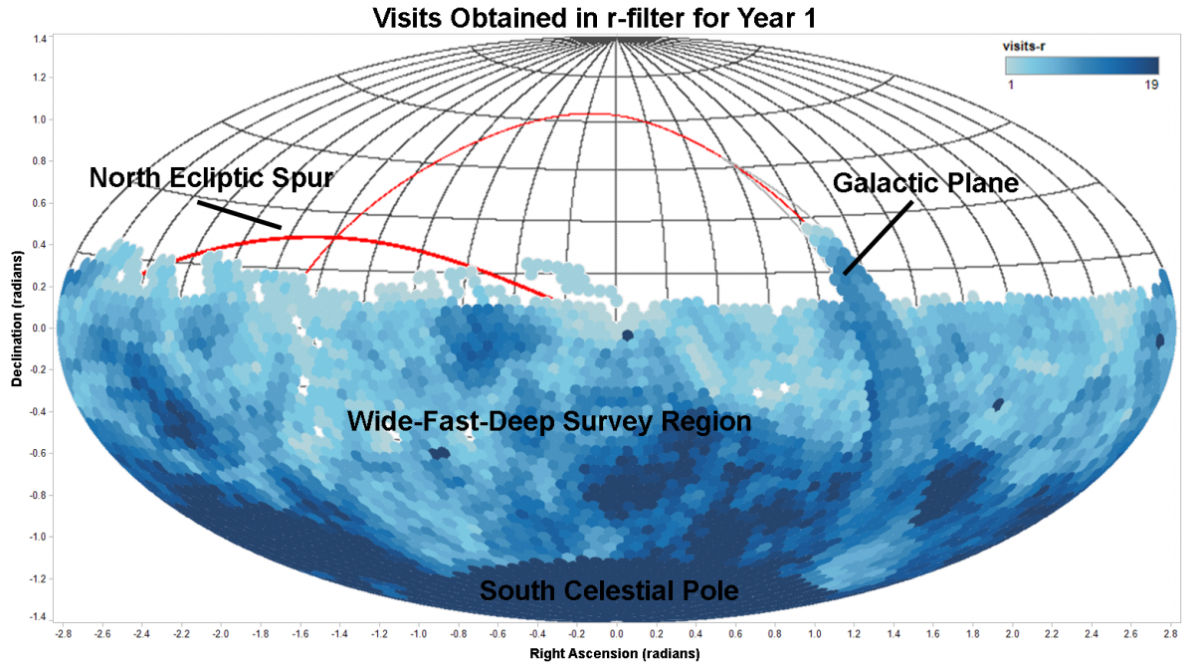
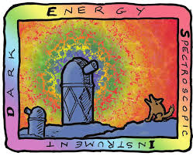
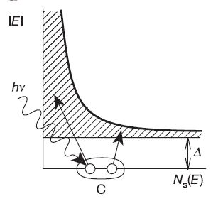
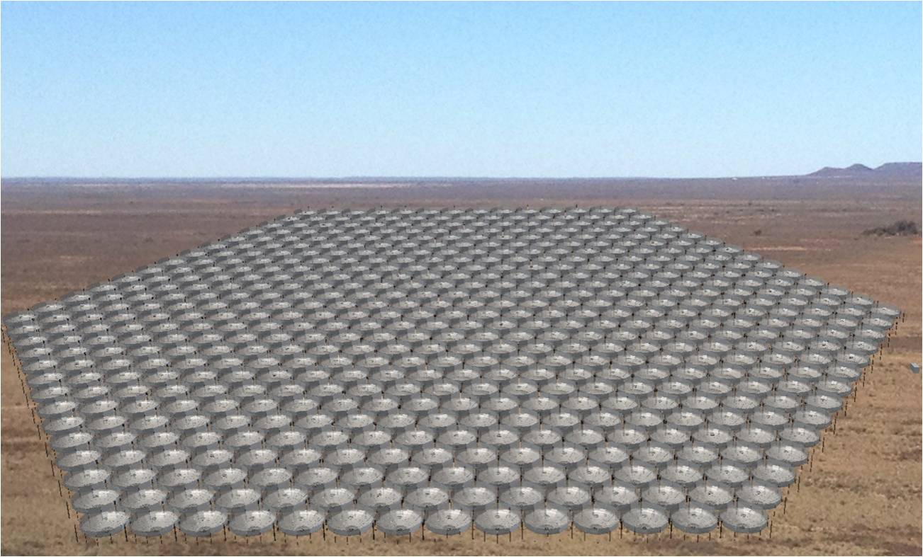
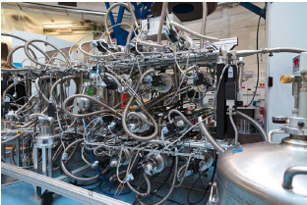
Findings
Southern Spectroscopic Survey Initiative
DESI-2
Billion Object Apparatus
21 cm
Low Resolution Spectroscopy aka Hi-Res Photometry
[2] There are multiple ideas for future projects that can mine that information

Slide 6
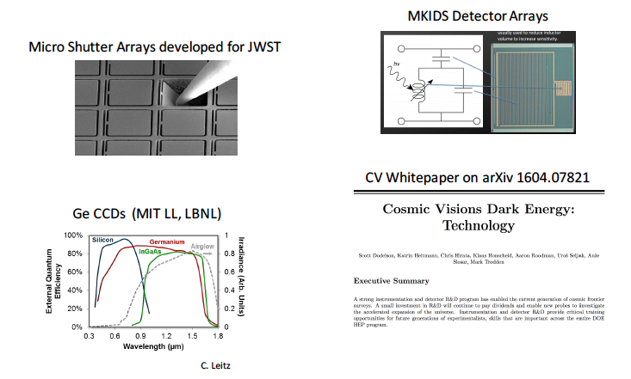
Findings
[3] Instrumentation R&D and new technologies will be key for most of these ideas

Slide 7
Recent Activity
Cosmology using Low-Resolution Spectroscopy https://kicp-workshops.uchicago.edu/LowResCosmology2020/overview.php (35 participants)
SSSI https://indico.hep.anl.gov/indico/conferenceDisplay.py?ovw=True&confId=1035 (40)
Future Cosmic Surveys https://kicp-workshops.uchicago.edu/FutureSurveys/index.php (145)

Slide 8
DESI-2

Slide 9
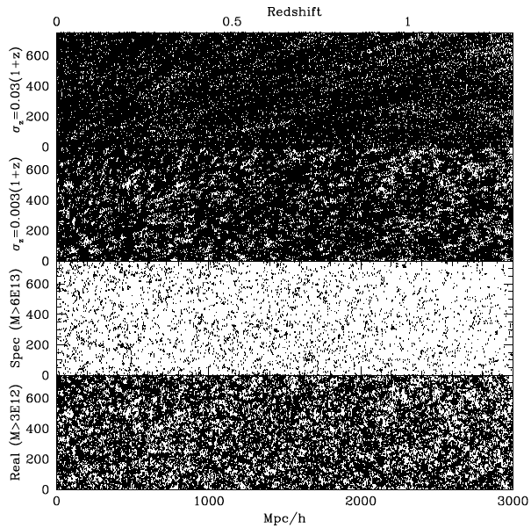
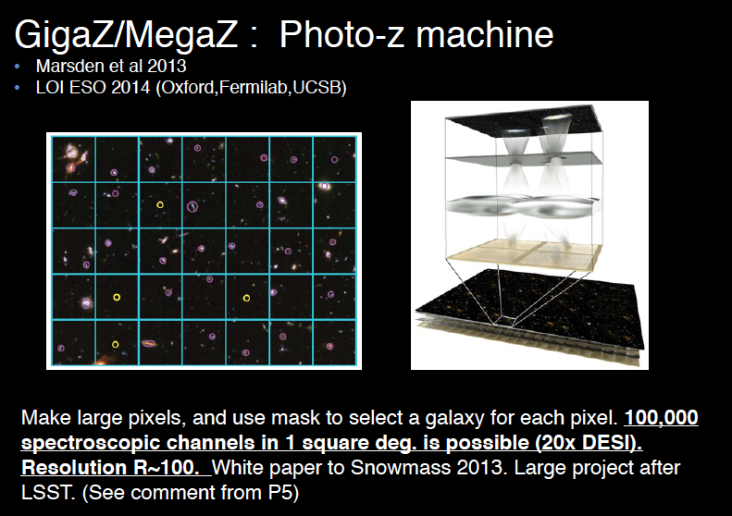
High-Res Photometry

Slide 10
Southern Spectroscopic Survey Instrument
SSSI would be a massively multiplexed (>2500x), wide-field (goal: >1 deg²) optical/IR spectrograph on a 6.5+m telescope
SSSI provides spectroscopic capabilities matched to LSST and CMB-S4 survey areas and depths; Southern site preferable
SSSI takes full advantage of current technologies and DESI legacy
Wide variety of science cases; e.g.: reduce LSST photo-z errors by a factor of 2 via training spectroscopy
A top priority from Kavli/NOAO/LSST and international prioritizations as well as Cosmic Visions: many potential partners

Slide 11
Billion Object Apparatus
Concept: optical/IR spectrograph on a 10m telescope
massively multiplexed (50k-100k fiber)
wide-field (1-5 deg²)
Primary Objective: complete sampling of linear density field using between 500M and 1B spectroscopic tracers
Maximal precision on cosmological constraints with clustering to z<3.5
Feasibility: shares instrument design with existing/proposed experiments
Design for 10-m class telescope with large FOV (Pasquini et al., 2016)
Spectrograph design for DESI adaptable to 4th infrared channel (1-1.4 micron)
Tests of target selection and spectroscopic completeness with PFS
Programmatics: Staged development with other spectroscopic surveys
Similar spectrograph design to DESI, DESI-II
Shared platform with SSSI
Partnership with DOE labs: R&D to meet technical challenges
Dense packing of fibers in focal plane
Scale spectrograph production to 100,000 fibers
Development of Ge CCDs at LBNL

Slide 12
Road Map for Spectroscopy
The proposed spectroscopic surveys build on each other directly
DESI-2 would be relatively low in cost and could follow DESI immediately in 2024
Spectrograph upgrades to add IR arm would enhance capabilities at higher redshifts
Moving to Blanco is an option, increasing LSST overlap
SSSI could reuse DESI spectrographs to reduce costs
Earliest possible deployment c. 2026
Most efficient option would be to deploy on 11-12m telescope (e.g. MSE or European wide-field concepts)
BOA would require both a >10m wide-field telescope and significant hardware R&D
Earliest possible deployment early 2030s
Could utilize telescope originally developed for SSSI

Slide 13
Radio Cosmology: 21 cm/Intensity Mapping
Near term: Forecasts tailored to v. high radial resolution of radio cosmology; use existing instruments to uncover systematics and try to constrain τ for CMB-S4 neutrinos.
Long term: Pushing the redshift, scale, and sensitivity frontiers with BAO measurements from 2 < z < 6; matter power spectrum on small scales at z > 35.
Contrast with the SKA: Proposed instruments would be targeted cosmology experiments, rather than the SKA’s philosophy of a general observatory, allowing fundamental physics to be probed at a fraction of the cost.
Partnerships with DOE labs:
High data rates: DOE HEP expertise in high throughput computing.
Next-gen correlator tech leveraging DOE radio frequency tech.
R&D for real-time ionospheric calibration for highest z.
Large scale DOE manufacturing capabilities for ~10⁶ element “dream cosmology instruments”

Slide 14
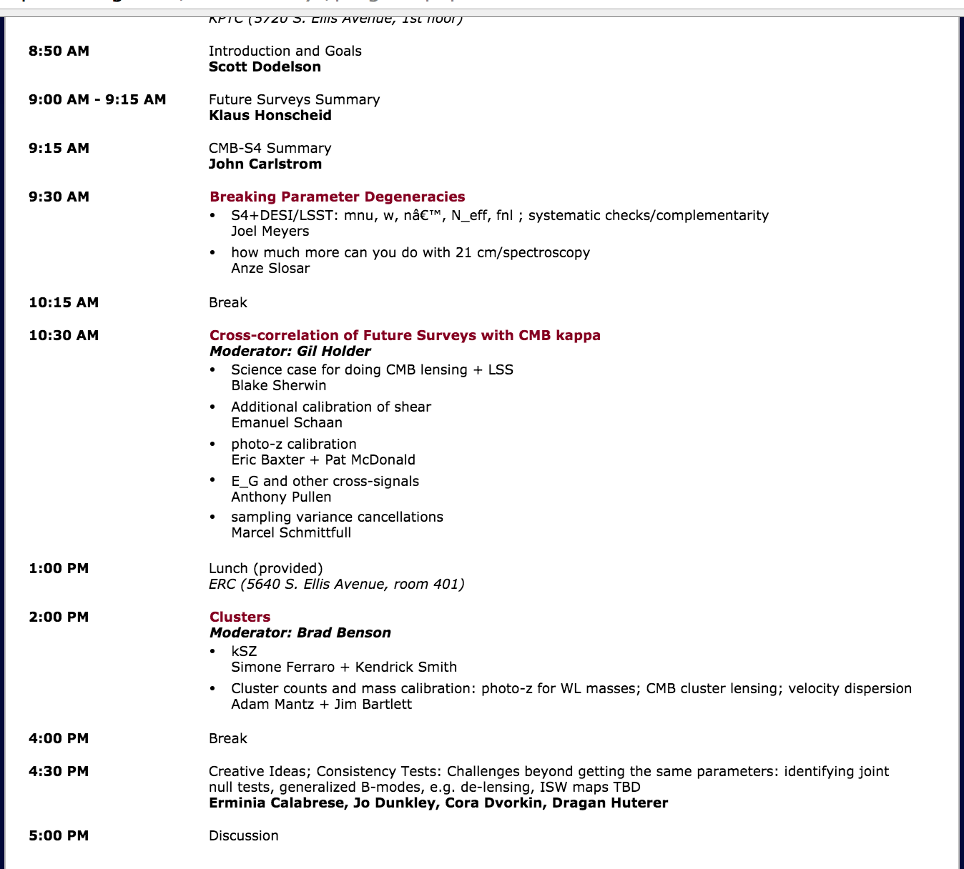
Overlap Day with CMB-S4

Slide 15
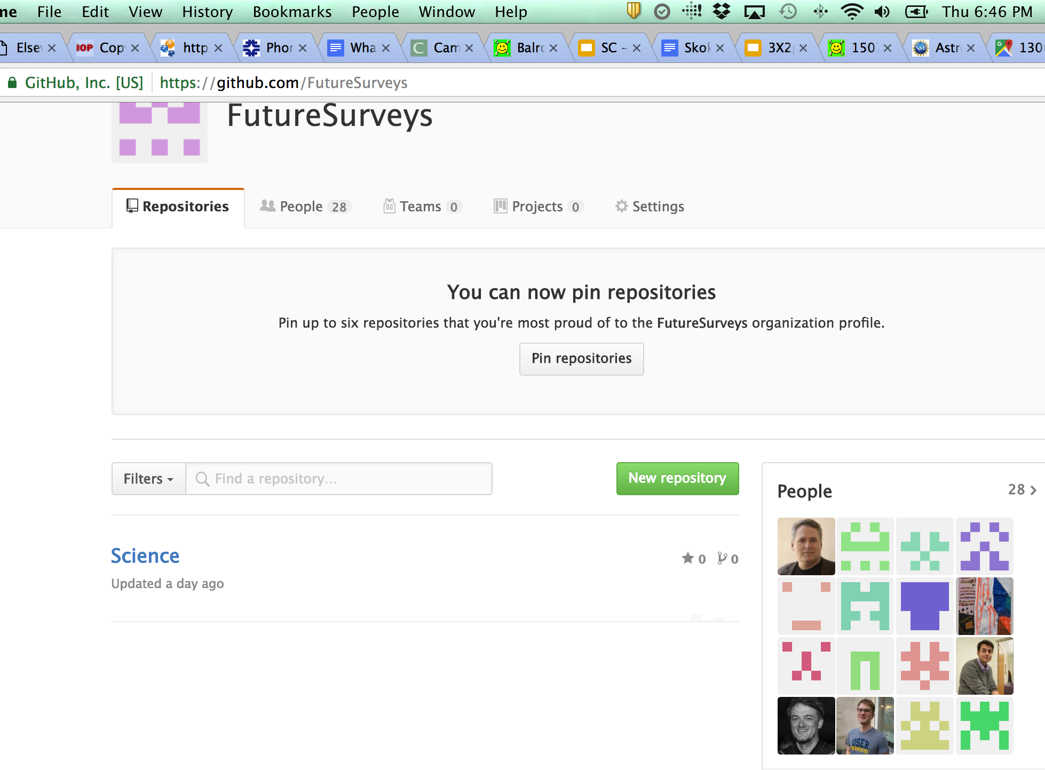
Our Next Steps
Proceed together generating projections over the next 6 months-one year, with telecons once every 2 months
Git Organization: allows for code sharing, prediction comparisons, writing, issues, …
Another workshop in one year with the goal of starting writing by then

Slide 16
What Would We Like from AAAC?
A recommendation like the one in the 2016 report: ““We encourage DOE, NSF, and university community to continue working toward a plan for a future (Stage 4) ground-based CMB experiment.”
Maybe premature for the 2017 report, but we wanted to get on your radar.

Slide 17
Backup

Slide 18
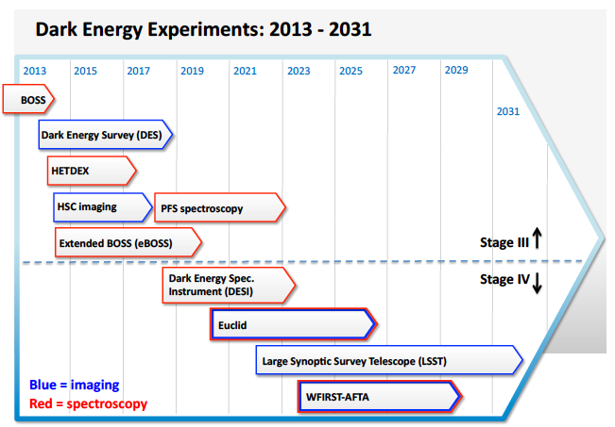
Context

Slide 19
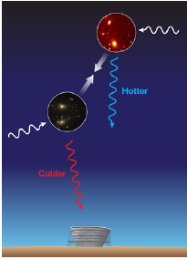
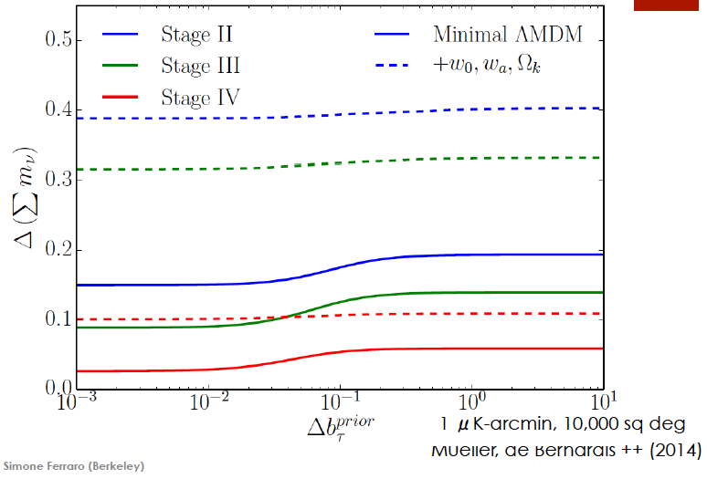
Overlap with CMB: kinetic Sunyaev-Zel’dovich Effect (kSZ)

Slide 20
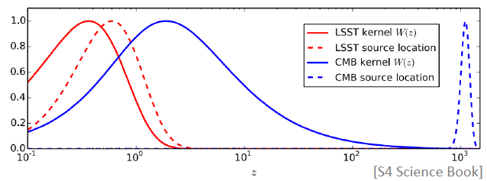
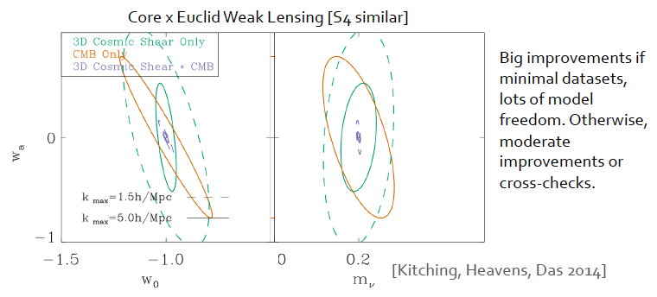
Overlap with CMB: Lensing

Slide 21
